Slide 1
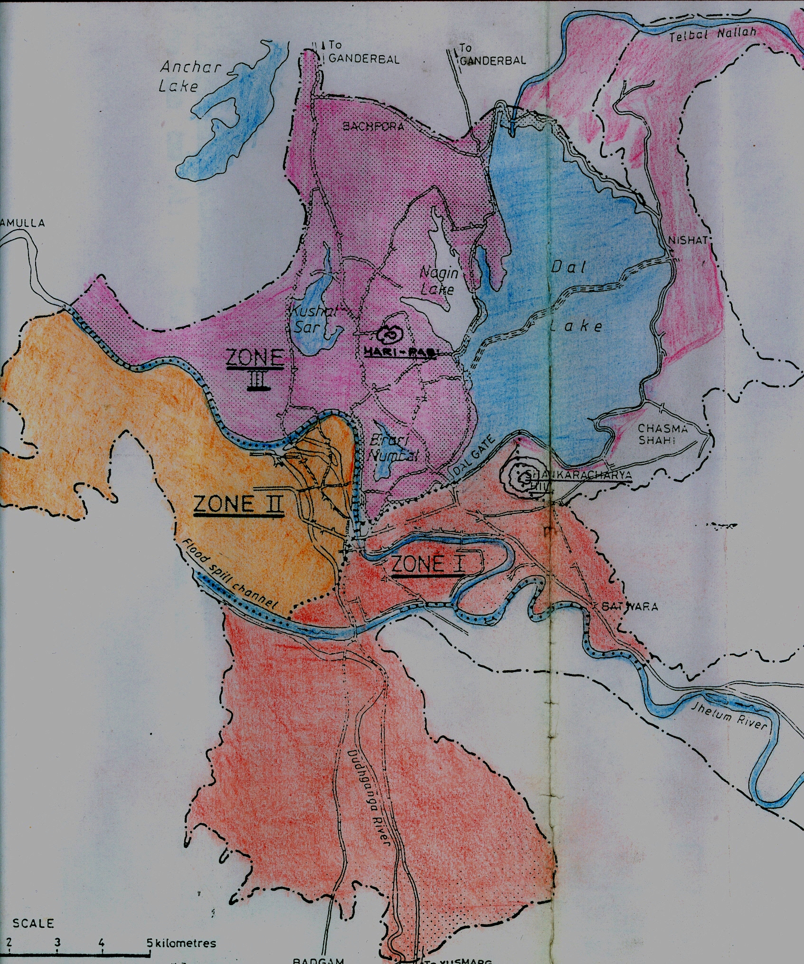
Sewerage Disposal for Srinagar City

Slide 2
SALIENT FEATURES
Total Area : 120.27 Sq Kms
Population (2011 Census): 13.34 Lac (including floating tourist)
Design Year: 2044
Design population: 24.83 Lac
Sewage Generation @ 80% 0f 155 LPCD
Present(2011): 165.41 MLD
Design year(2044): 308 MLD
Present Installed and functional capacity: 53.80 MLD (33%)
Under Construction STP Noorbagh: 60.00 MLD (36%)
Present Shortfall: 51.20 MLD (31%)

Slide 3
Present Status of Sewerage System
Out of three zones only Zone (3) has been taken up for Sewerage Disposal.
Existing at present
LAWDA: 5 STPs with installed capacity of 36.70 MLD
STP Laam = 4.5 MLD
STP Habak= 3.2 MLD
STP Hazratbal= 7.5 MLD
STP Brari Numbal= 16.1 MLD
STP Nallah Amir Khan= 5.4 MLD
UEED: 1 STP with Capacity of 17.1 MLD
STP Old Brari numbal= 17.1 MLD
Under Construction: 1 STP of capacity 60 MLD
60 MLD STP at Noorbagh under JnNURM through NBCC

Slide 4
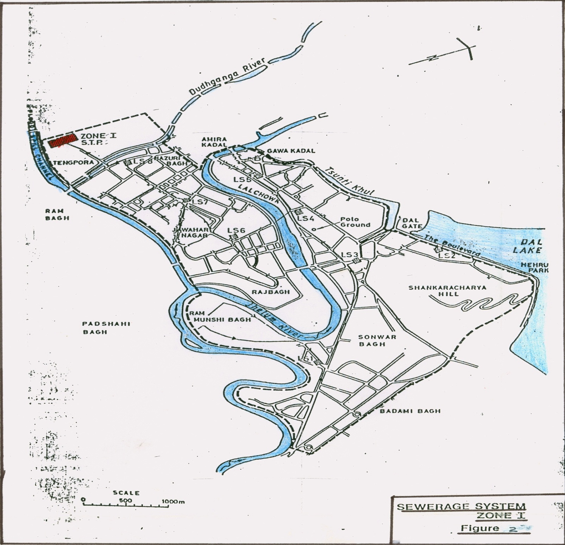
Zone 1
Area falls on right of River Jhelum from Batwara to Gaw Kadal including Batwara, Sonwar Civil Lines area bounded by River and lalChowk. Left of River Jhelum from Kursoo to Amira Kadal. Area acrosss flood spilll channel including Rambagh to Barzallah Natipora etc.

Slide 5
Zone 1
Area: 34.28 Sq Kms
Population (2011): 4.19 Lac Persons
Intermediate (2021): 5.09
Design Population (2044): 7.82
Number of House Holds: 69800 @ 6 PPH
Number of Hotels: 166
Connectivity Nil as no infrastructure is in place.

Slide 6
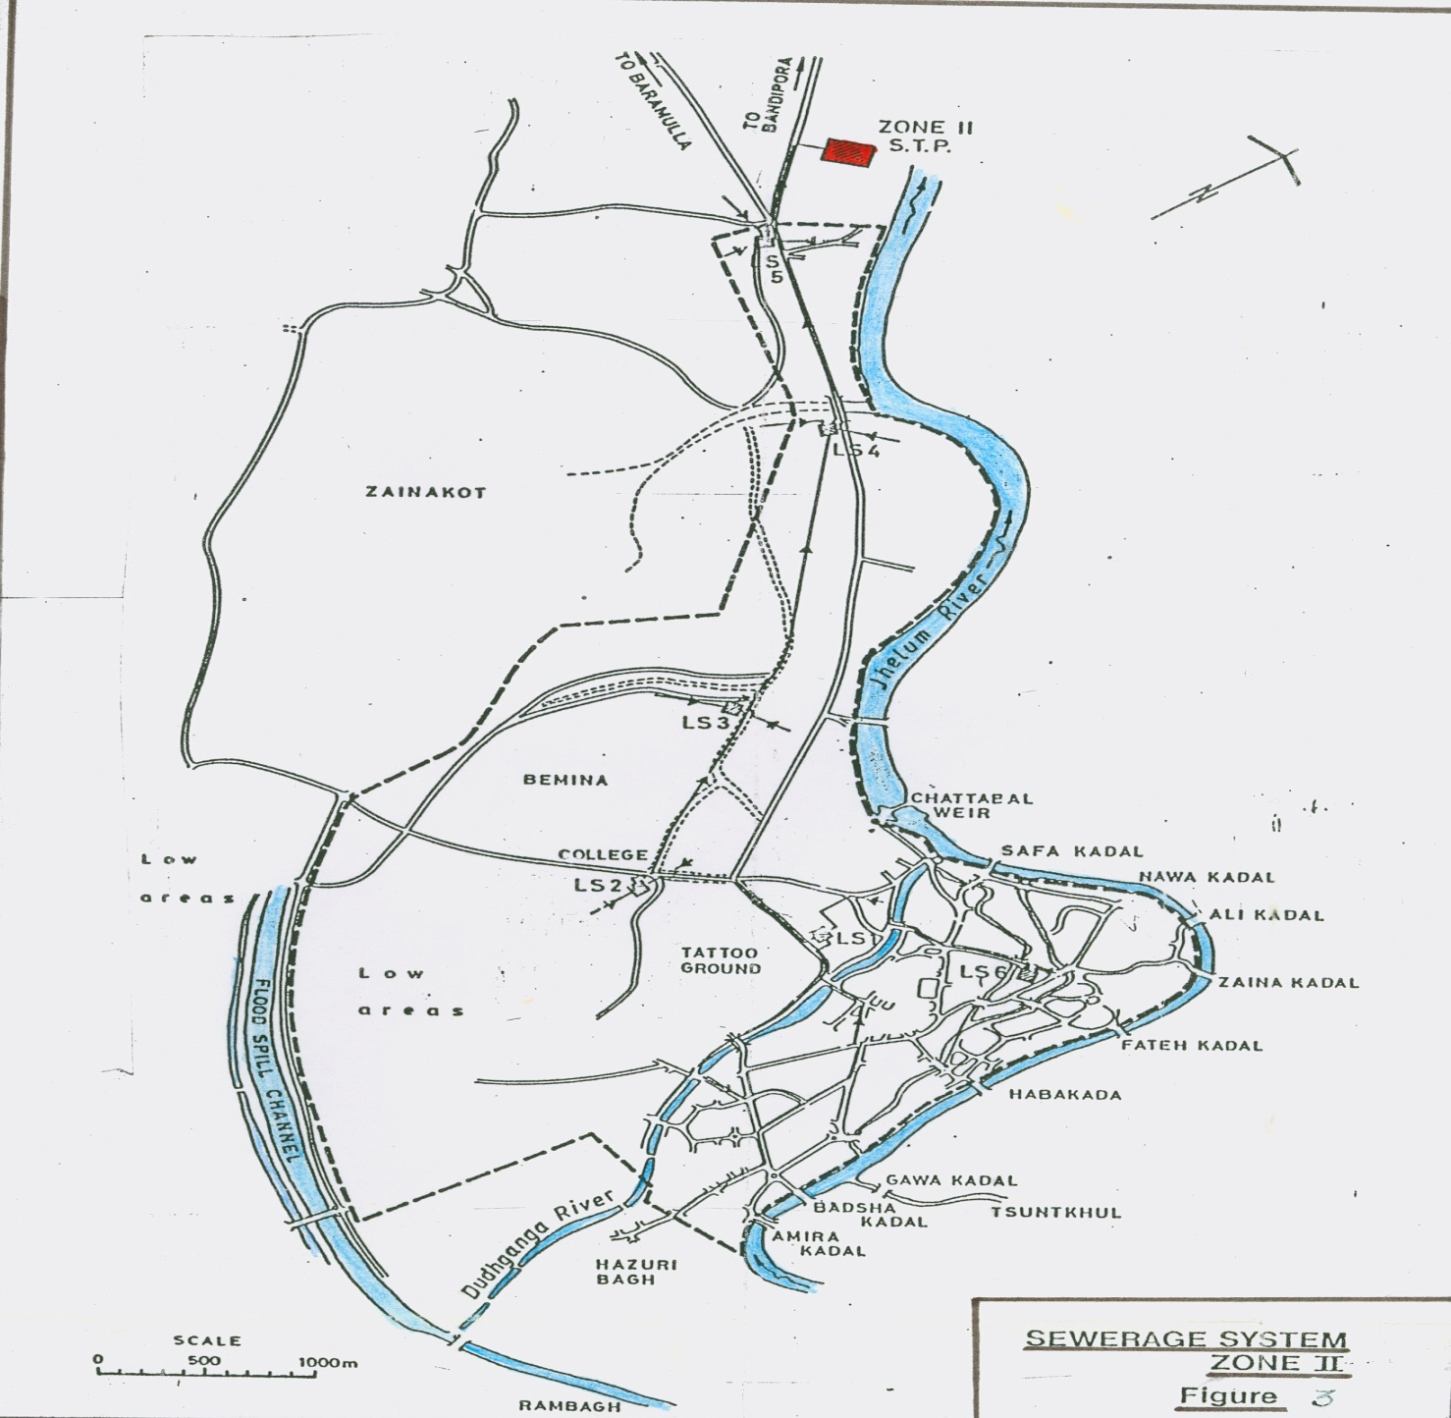
Zone 2
Area falls on left of river Jhelum from Amira Kadal to Shalteng, Bemina and also old city on left bank of River Jehlum.

Slide 7
Zone 2
Area: 39.98 Sq Kms
Population (2011): 3.07 Lac
Intermediate (2021): 3.70 Lac
Design Population (2044): 5.72 Lac
Number of House Holds: 51100 @ 6PPH
Number of Hotels: 19
Connectivity Nil as no infrastructure in place.

Slide 8
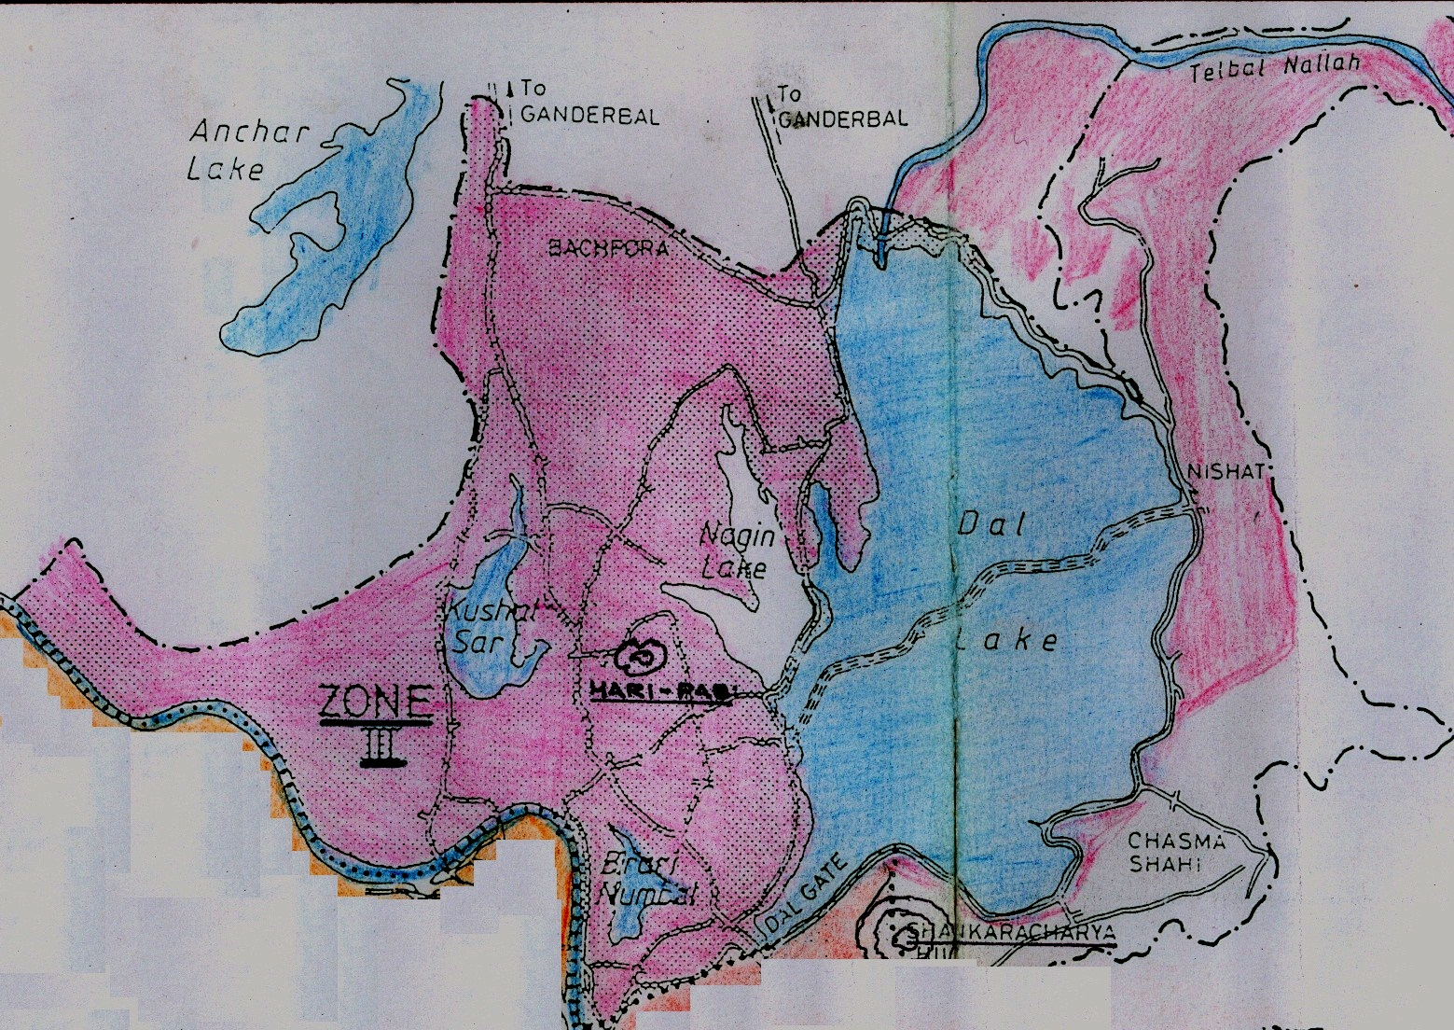
Zone 3
Area falls on right of River Jhelum from Dalgate to Noorbagh on one side and Dalgate to Harwan via Boulevard, Dalgate to Zakora via Rainawari on the other upto Buchpora, Umerhair.

Slide 9
Zone 3
Area: 46.01 Sq kms
Population (2011): 6.08 Lac
Intermediate (2021): 7.32 lac
Design Population (2044): 11.29 Lac
Number of House Holds: 101000 @6 PPH
Number of Hotels: 177
Out of 177 Hotels, 108 Hotels are connected with Sewerage Network of STPs.

Slide 10
General Abstract of Existing/Proposed Sewerage Network of Srinagar City
Zone | Population Year (Lac ) |  |  | Catchment Area | Sewage Generation (MLD) |  | Present No. of |  | Left out Hotels
 | 2011 | 2021 | 2044 | Sq Kms | 2011 | 2044 | Houses | Hotels
I | 4.19 | 5.09 | 7.82 | 34.28 | 51.96 | 96.96 | 69800 | 166 | All
II | 3.07 | 3.70 | 5.72 | 39.98 | 38.06 | 70.92 | 51100 | 19 | All
III | 6.08 | 7.32 | 11.29 | 46.01 | 75.39 | 140.0 | 101000 | 177 | 69
Total | 13.34 | 16.11 | 24.83 | 120.27 | 165.41 | 307.88 | 221900 | 362 | 254
Financial requirements in the year 2014 @ 13 Crores/MLD for additional 194 MLD =2522 Crores

